Slide 1


Surgical Theatre Lists
Patient Finder Tool
Business Intelligence | Automation & Advanced Analytics

Slide 2


About the team
Andrea Jackson
Manager, Automation and Advanced Analytics
Jane O’Connell
Senior Transformation Partners

Slide 3
Project Background
Problem:
Gaps in available theatre time when building theatre lists, after scheduling high-priority patients.
Goals:
Predict operating times using historical data.
Leverage priority data to recommend patients that best fit available gaps for a given surgical specialty.
This initiative is part of the Surgery Division program of work. The aim is to facilitate extra cases to planned theatre lists, optimising the use of resources, improving the efficiency of full and half day lists.
The proposed value proposition is as follows:
If we can add an extra case to 10-20% of our planned lists, we would serve an additional 1300-2500 cases per annum.

Slide 4
Observation Data
This project focuses on applying the model to waiting list records. Therefore, the data utilized will be restricted to fields available within the waiting list data, along with some insights from prior visits by the patient's history.
We have 2 main dataset:
Waiting_list: patients who are waiting for surgery
Surgery_patients: contains the surgery information combined with waiting list information
Extracting data conditions:
Patients who were added to waiting lists in 01/01/2020 - 01/08/2024
The patient must have surgery within 01/07/2022 - 01/07/2024 to be used in sample
Extract only the information of patients who are over 17 years old
Only cases that actually performed are listed

Slide 5
Outcome Data – Theatre Time (Surgery Length)
Target variable: Surgery Length
Surgery Length = Out of Theatre Date time – Into Theatre Date time
Fitting the model
Estimate the impact of key factors, such as:
Specialty of surgery
Patients’ historical records
Apply Estimation to Prediction
Use the estimated factors to predict theatre time
Apply Predicted Values to Front-end tool

Slide 6
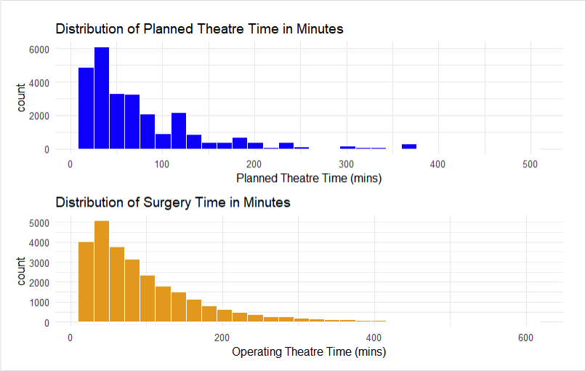
Overview of the data
Insights:
The distribution of planned theatre times is more clustered around lower durations (peaking below 100 minutes), whereas the actual surgery times follow a longer tail, indicating many surgeries take more time than planned
This discrepancy between human estimates and real-life surgery durations highlights potential inefficiencies or underestimation in scheduling

Slide 7
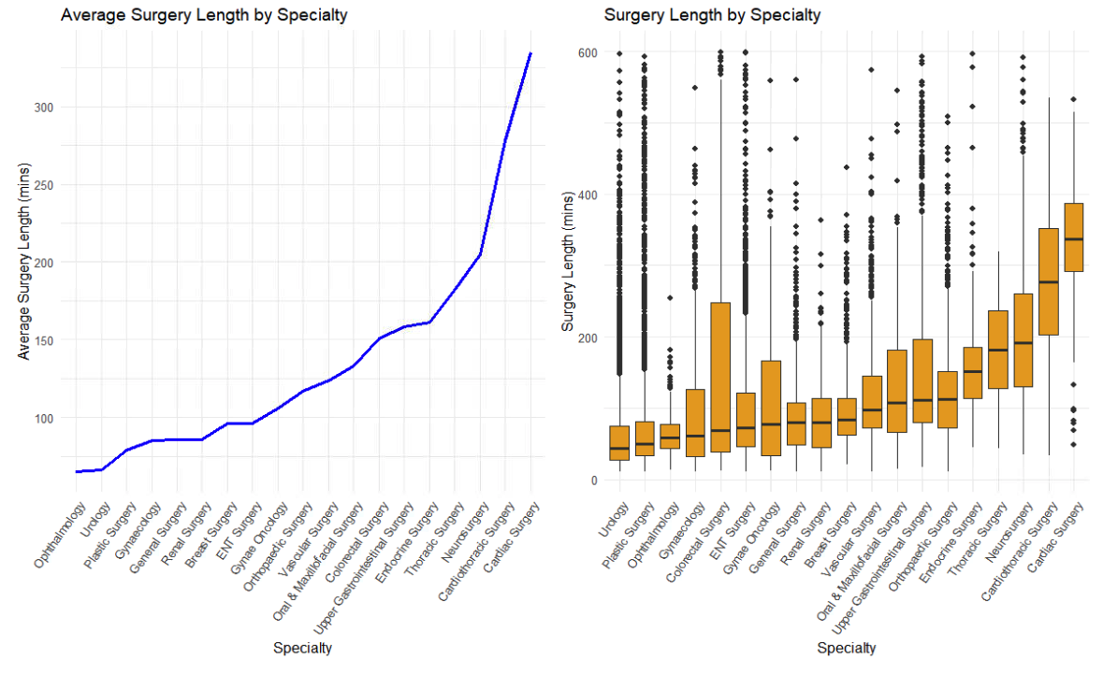
Overview of the data
Insights:
Specialties such as Cardiac Surgery, Cardiothoracic Surgery, and Neurosurgery have the longest average surgery times, with Cardiac Surgery reaching over 300 minutes
On the other end, specialties like Ophthalmology and Urology have significantly shorter surgery lengths, often under 100 minutes

Slide 8
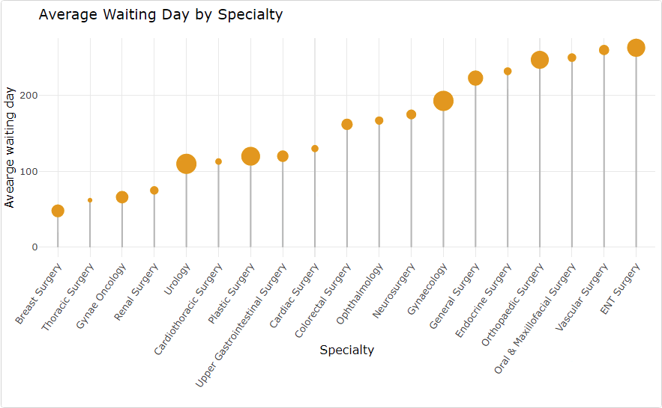

Overview of the data
Insights:
Around 84% of surgeries are performed within a year, leaving 16% as long-waiting surgeries, raising concerns the model prediction efficiency for long-waiting cases

Slide 9
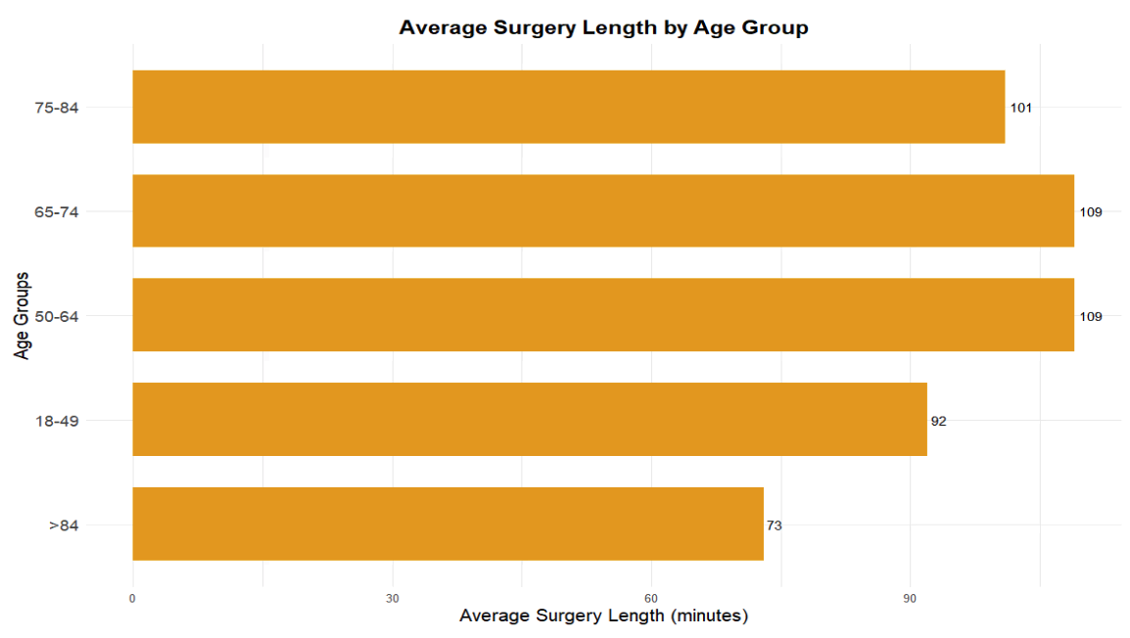
7 Features Engineering
AgeGroupAtDateOfRemoval
Insights:
The oldest age group (over 84 years) has the shortest average surgery time, while the 65-74 and 50-64 age groups have the longest.
Assumption: This might indicate prioritization of faster surgeries for older patients or less invasive procedures.

Slide 10
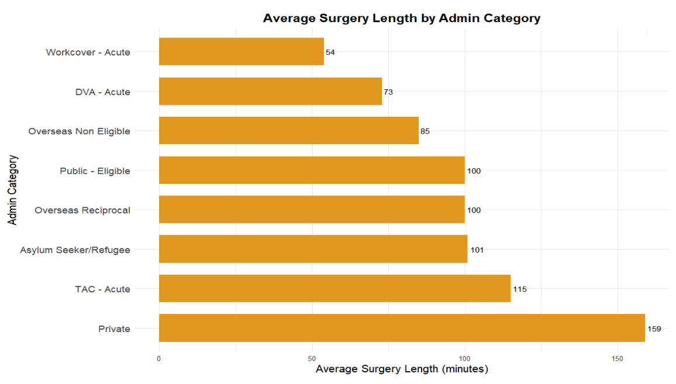
7 Features Engineering
AgeGroupAtDateOfRemoval
AdminCategory
Insights:
Private patients have the longest surgery times, averaging 159 minutes, followed by TAC - Acute cases.
Workcover and DVA - Acute cases are much shorter, around 54-73 minutes
Assumption: This possibly due to different patient profiles or types of surgeries covered by these categories.

Slide 11
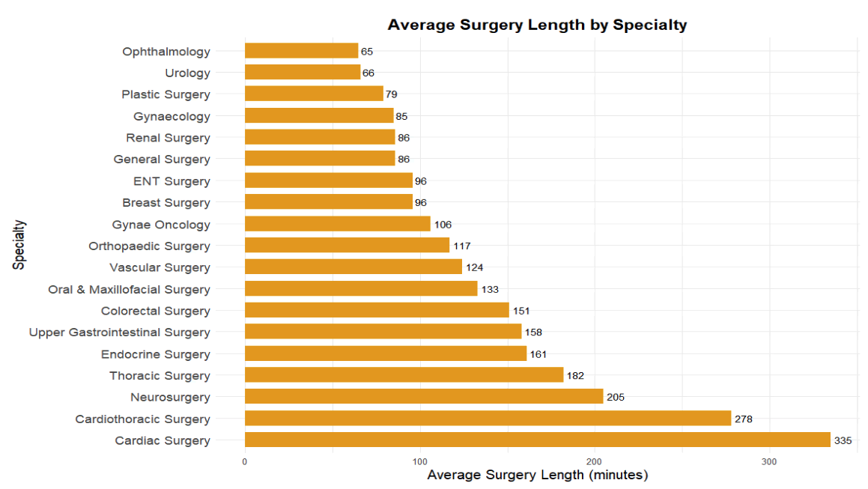
7 Features Engineering
AgeGroupAtDateOfRemoval
AdminCategory WaitingListSpecialtyDesc
Insights:
More complex specialties require more theatre time

Slide 12
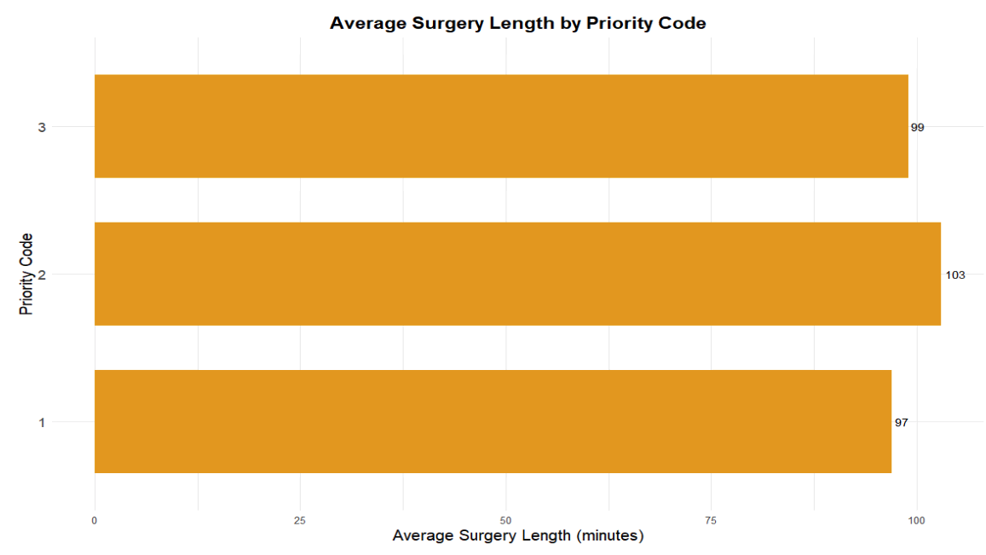
7 Features Engineering
AgeGroupAtDateOfRemoval
AdminCategory WaitingListSpecialtyDesc CurrentPriorityCode
Insights:
Even with varying priorities, the surgery length does not significantly differ by priority

Slide 13
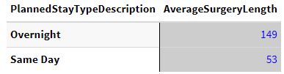
7 Features Engineering
AgeGroupAtDateOfRemoval
AdminCategory WaitingListSpecialtyDesc CurrentPriorityCode PlannedStayTypeDescription
Insights:
Overnight stays have significantly longer average surgery times compared to same-day procedures (149 vs. 53 minutes), indicating more complex surgeries are linked to overnight care.

Slide 14
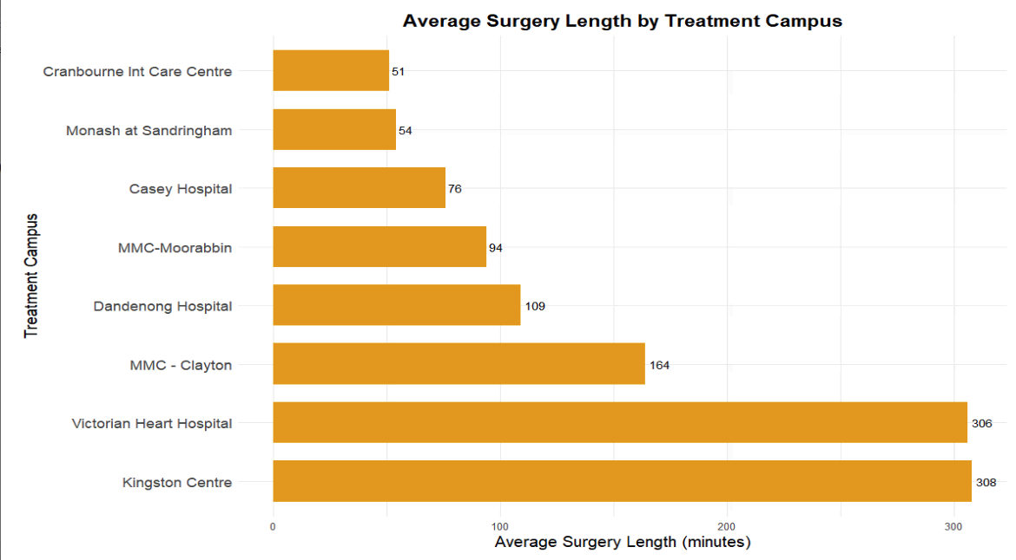
7 Features Engineering
AgeGroupAtDateOfRemoval
AdminCategory WaitingListSpecialtyDesc CurrentPriorityCode PlannedStayTypeDescription TreatmentCampusName
Insights:
Different campuses may specialize in particular types of surgeries that take longer, or there may be differences in patient complexity across facilities.

Slide 15
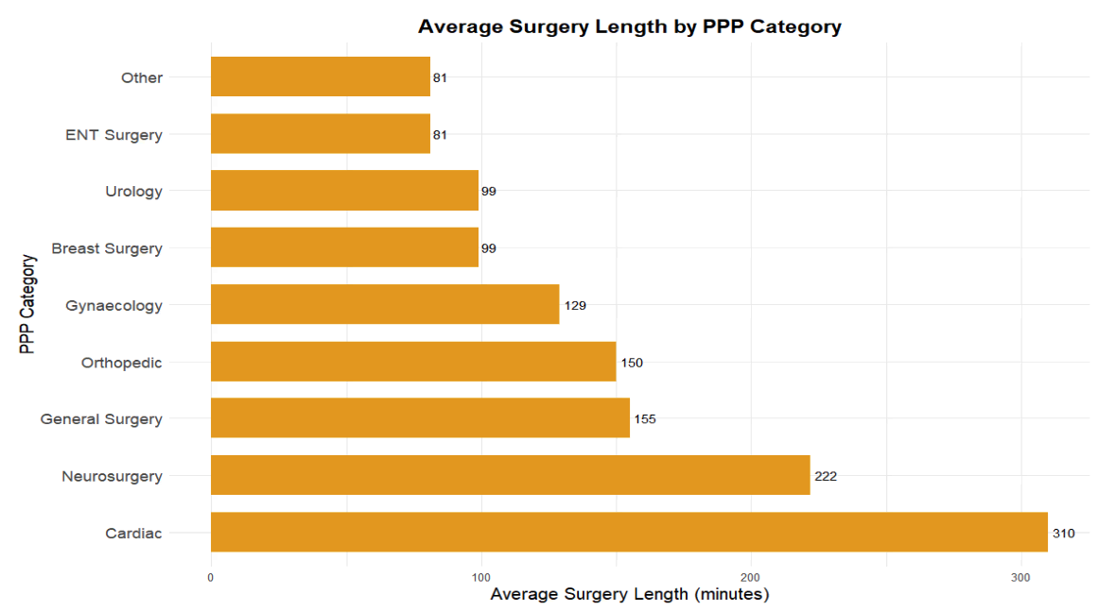
7 Features Engineering
AgeGroupAtDateOfRemoval
AdminCategory WaitingListSpecialtyDesc CurrentPriorityCode PlannedStayTypeDescription TreatmentCampusName PPPCategory
(The Principal Prescribed Procedure)
Insights:
Cardiac and Neurosurgery are the longest surgeries in the PPP category, while ENT Surgery and Urology are among the shortest, consistent with trends observed in the specialty breakdown.

Slide 16
Model Fitting Process
Data Preparation
Prepare the train and test set
Cross-Validation Setup
Cross-validation split into 5-fold cross-validation on the train data to split data into training and validation sets.
Model training and hyperparameter tuning
Train multiple model: Linear Regression, Ridge, Lasso, RF, GBM
Set consistent factor levels across the training and test sets
Ensure the stratification of WaitingListSpecialtyDesc.
Perform grid search for hyperparameter models
Evaluate model using RMSE, MAE and R-squared on the validation set
Predictions and Evaluation
Fit the model on train set
Make predictions on the full test set and select the best models
Final model selections and apply to the target variables on Waiting List

Slide 17
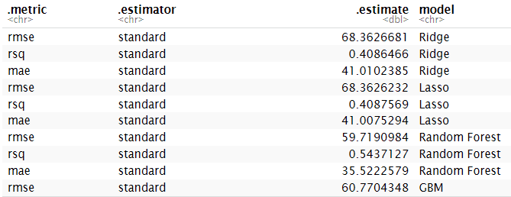
Model Fitting Process - Results
Insights:
Among those models, we got the Random Forest with the best result as it has the lowest RMSE (59.72)
The R-squared (0.543) is also the highest, which suggests that 54.3% of the variability in surgery length can be explained by the model.
Additionally, MAE (35.52) is relatively lower, indicating that, on average, the predictions are off by about 35.52 minutes from the true surgery lengths.

Slide 18
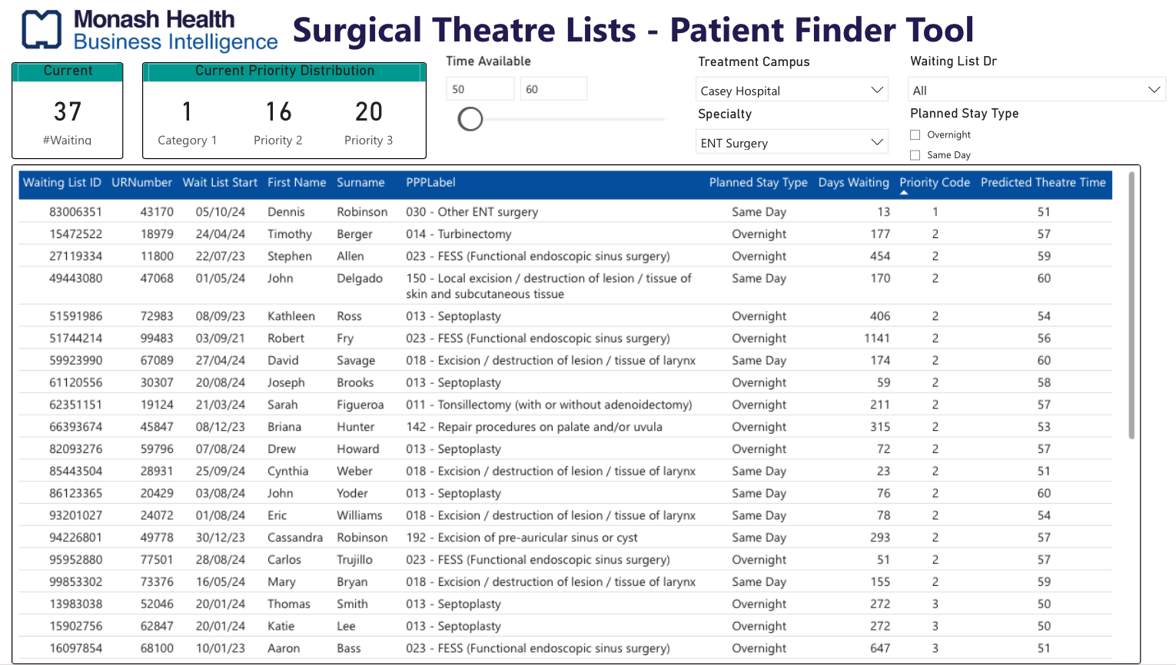
Patient Finder Front-end Tool
Patients will be priorited using:
Priority Code
Total Waiting Day until the day the tool used
Assumptions:
Remove all patients with scheduled theatre time
Who will be the front-end user:
Nurses can use this tool when there’s available theatre slot
Benefits of the tool:
Medical benefit: More patients can be treated, assuming extra 10-20% theatre case
Financial benefit: Financial efficiency for the institution, as half-day theatre costs organization $6.7k

Slide 19
Thank you for listening! It’s Q&A time 🤩

